Slide 1
Title Layout alternate
NJSOM Fall Conference
Update from the Wacky World of D.C. & Cancer Care Implications
Ted Okon
Executive Director
October 9, 2025

Slide 2
Big Picture in D.C.
Title, Text Layout
SHUTDOWN!!!
As of 10/2, writing this presentation, there is a shutdown with no end in sight
Regardless of your politics and views, what we have seen unfolding in D.C. is like nothing we have experienced before
The GOP’s belief is that the federal government is bloated, inefficient, wasteful, and even allows fraud
Two parties are pitted against each other like never before in recent history (and it’s worse than you hear on cable news!)
Funding the government
One Big Beautiful Bill Act
Recissions
Epstein
Day and night
We won’t know how the staff and budget cuts to NIH, FDA, CMS, etc., will impact cancer research, drug approvals, etc., until possibly years down the road
It’s a brave (bizarre) new world in D.C.!!!

Slide 3
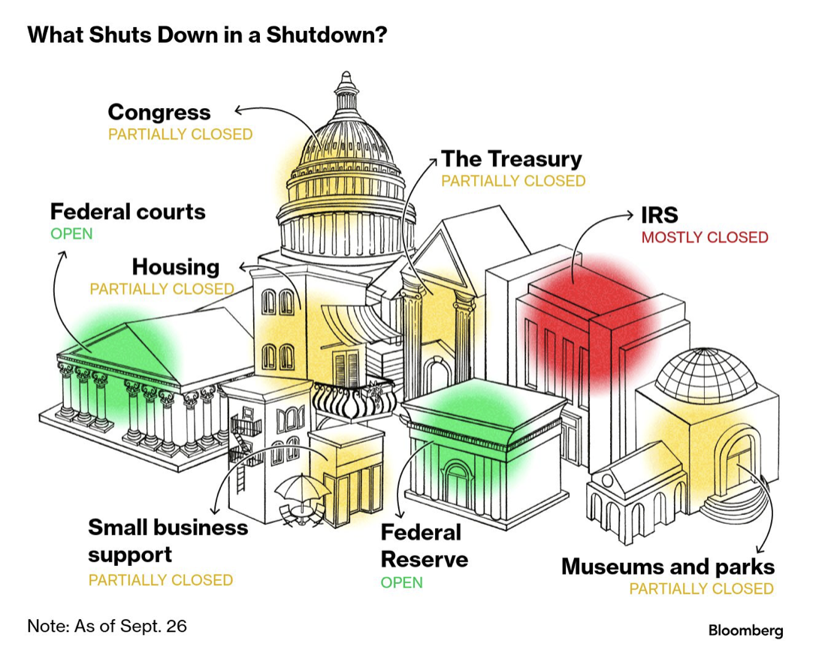
Implications of the Shutdown
COVID PHE telehealth waivers expired
Unclear how CMS will handle this during the shutdown
Medicare and Medicaid payments will be impacted if the shut down is prolonged
Right now, a 10-day MAC hold on claims is in effect
Unclear what/how furloughs and layoffs will impact HHS and CMS operations
Dems fighting over ACA subsidies expiring
Loss of insurance coverage

Slide 4
Top COA/Community Oncology Issues
CMS prohibiting practices from delivering oral cancer drugs to their patients
Cuts to Medicare reimbursement for physicians
A host of insurer/PBM issues
Spike in prior authorizations
Utilization management (”fail first” step therapy)
Low-ball Part D reimbursements
Restricting/directing biosimilar use
Mandatory mail order
Increasing cost of hospital care
Higher payment for the same service delivered in hospitals versus physician practices
Overpayment and abuses of the 340B Drug Purchasing Program
Inflation Reduction Act (IRA) and Medicare negotiating drug prices
Adverse unintended impacts of MFP lowering ASP

Slide 5
Update: The Stark Issue
COA is working hard with Congress to get legislation advanced to stop CMS
H.R. 5526 passed by the full House in 118th Congress
New version (H.R. 2484) introduced in this (119th) Congress and passed by the Energy & Commerce Committee
Working on Senate companion bill
Reached out to “new” CMS to fix this problem
FOIA request to uncover what prompted CMS to issue Stark FAQ
Totally ignored by CMS, so now in the court to force CMS to respond
NASP and NACDS lobbying this fix
They want to control drug dispensing

Slide 6
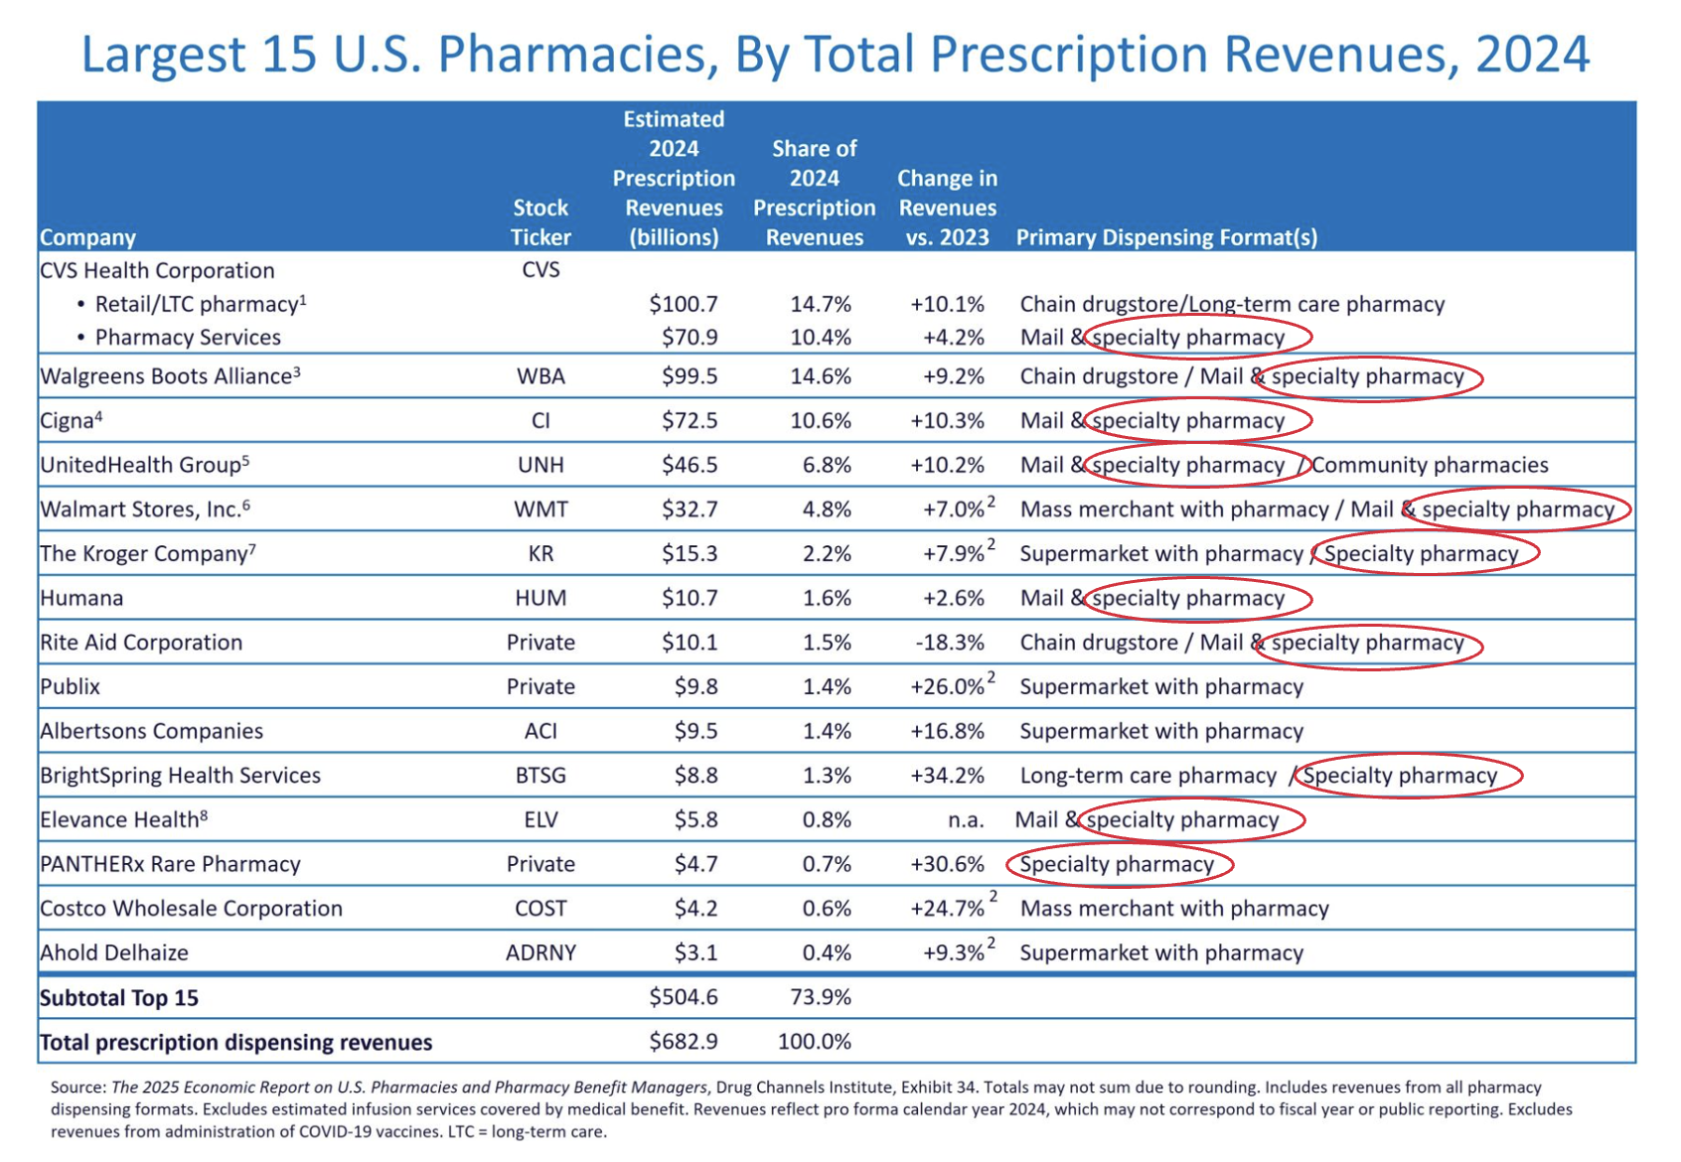
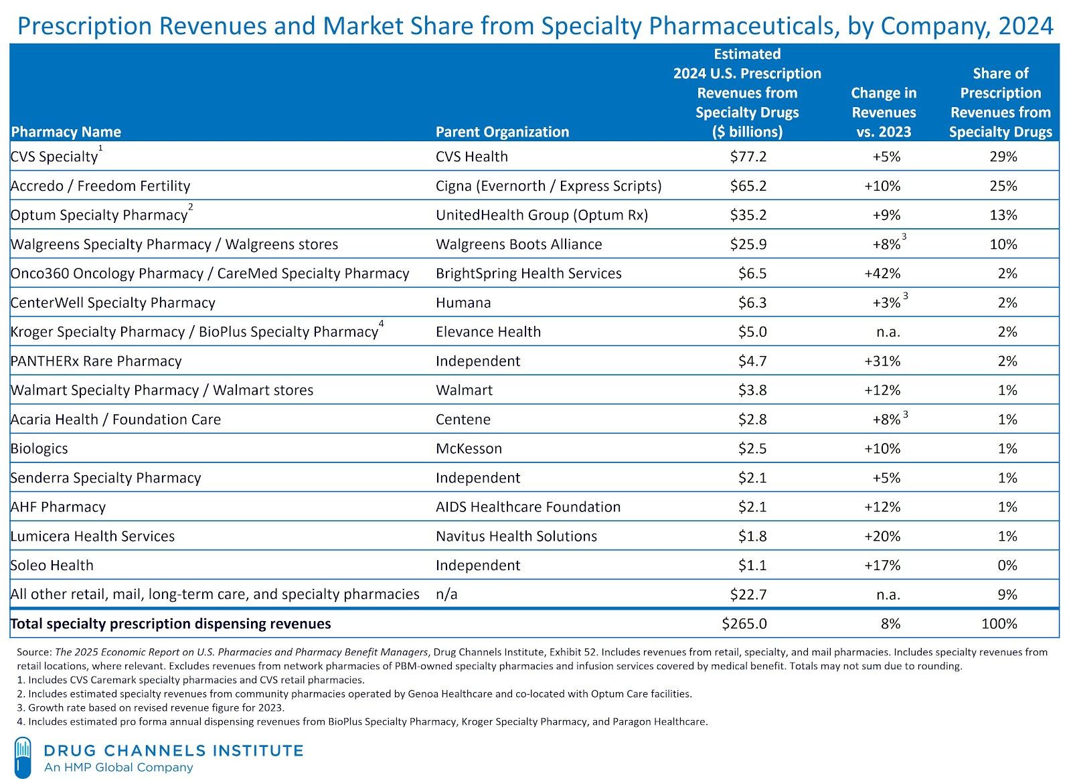
The War Over Who Dispenses Oral Cancer Drugs
57%
77%

Slide 7
Physician Medicare Pay Cuts Continue to Worsen

Slide 8
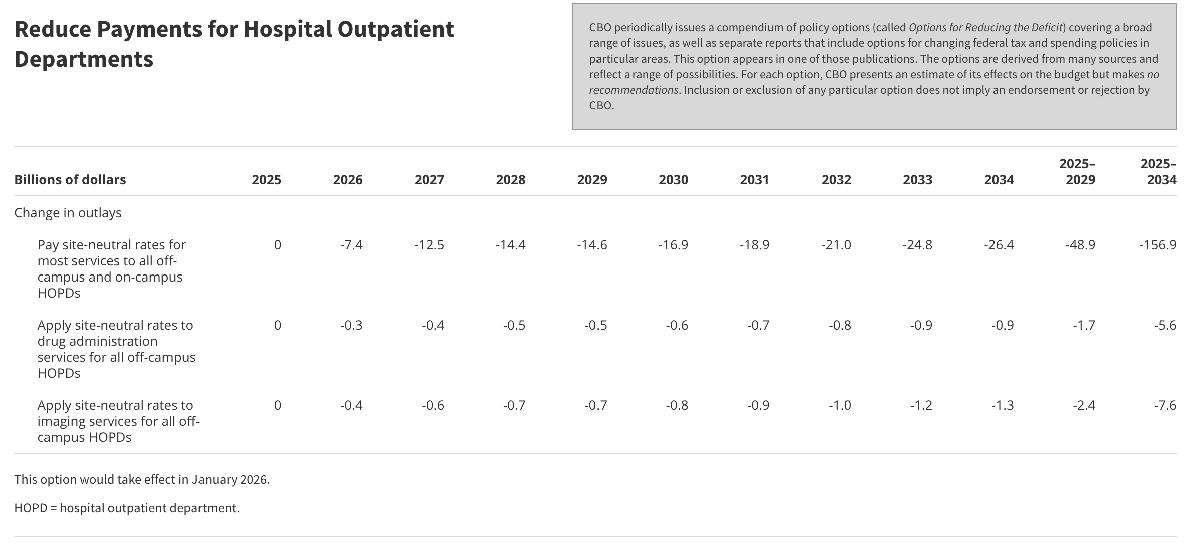
Solution is Fixing Pay Cuts With Site Neutrality

Slide 9
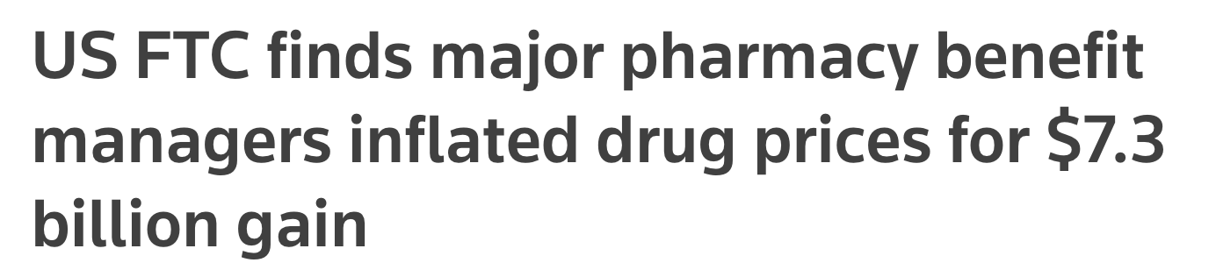
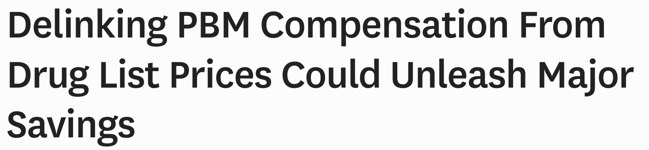
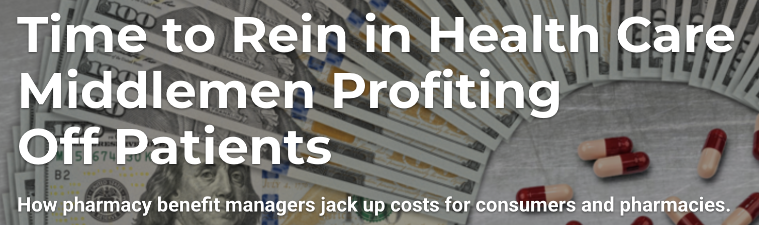
PBM Federal Legislation Stalled in the Red Zone

Slide 10
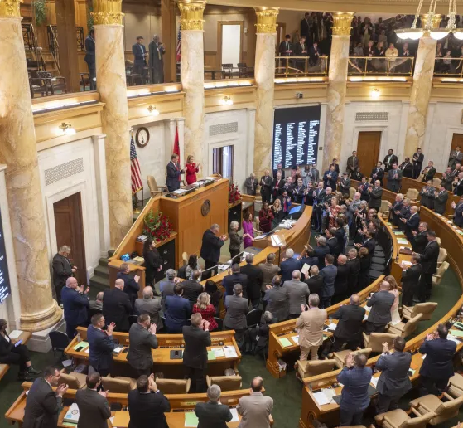
Lots of State Activity on PBMs Including Arkansas
Title, Text Layout
Act 624 prohibits a PBM (corporation) from owning a pharmacy
Signed into law by the Governor
Stayed due to PBM court challenge
Attorney General gearing up to fight
COA working with the AG to file an amicus brief

Slide 11
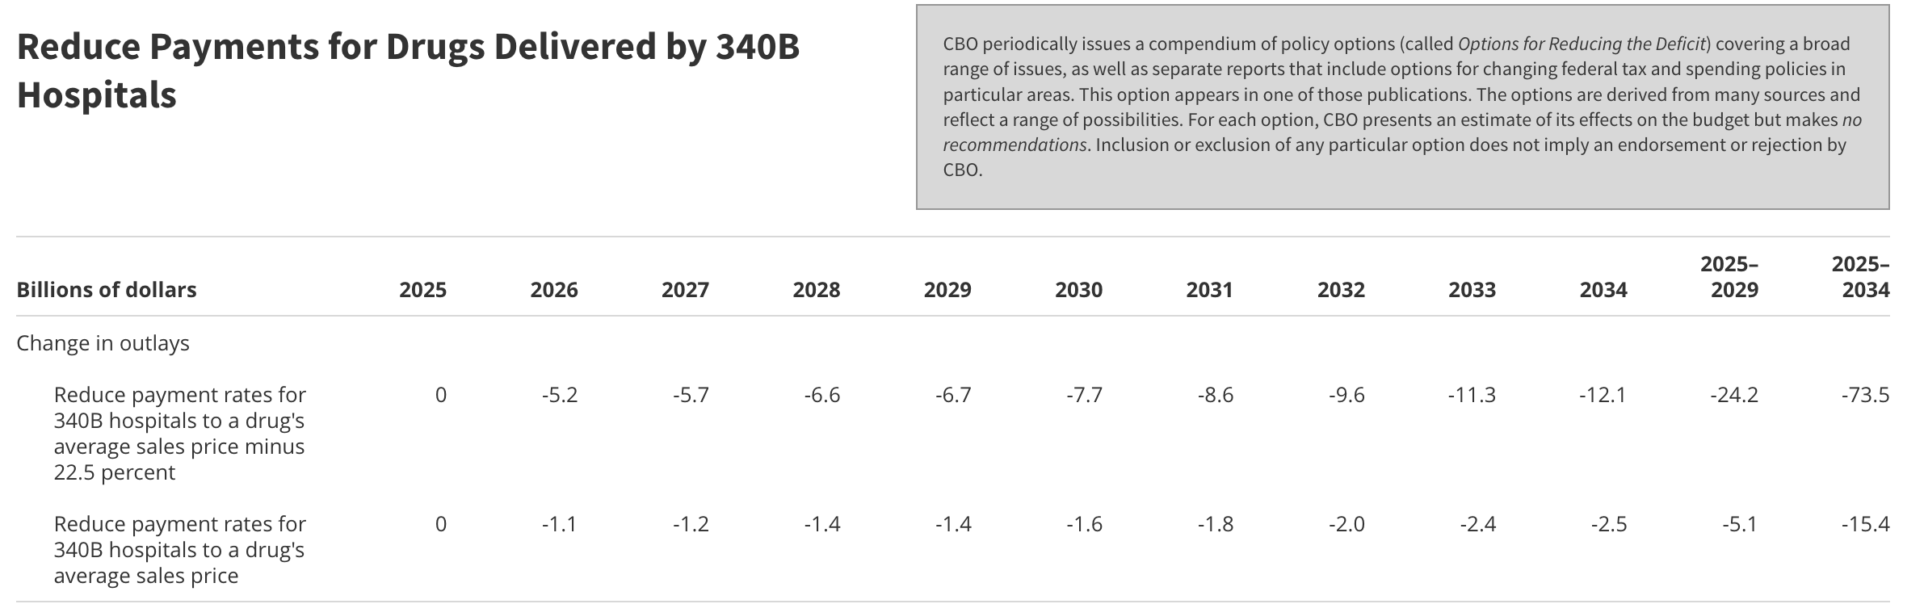
Latest on Congress and 340B Reform
Pharma wants to use 340B rebates, rather than blanket discounts, to better track 340B
Lots of court action may end up in the Supreme Court
Trump HHS/CMS proposing rebate pilot
Lots of money in regulating 340B
Trump HHS/CMS once again out to lower 340B reimbursement via the outpatient hospital rule
Expect pharma to keep fighting state contract pharmacy allowances

Slide 12
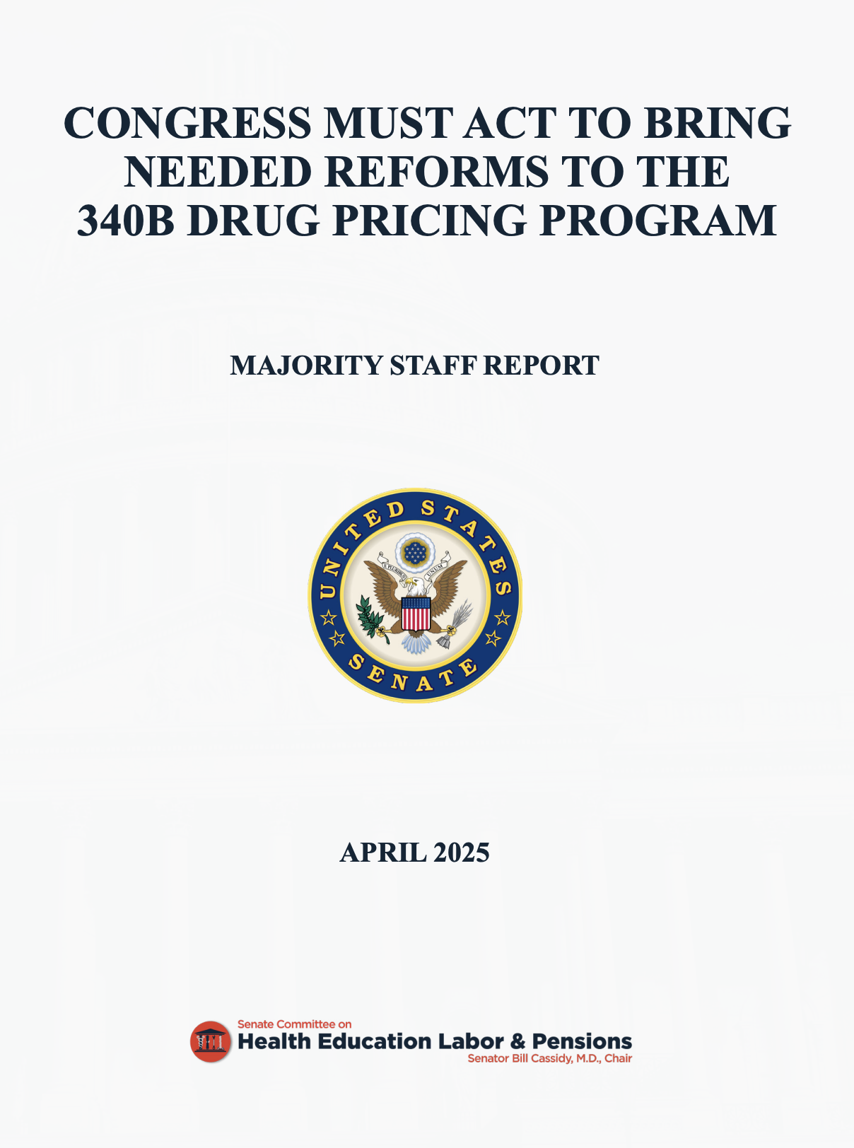
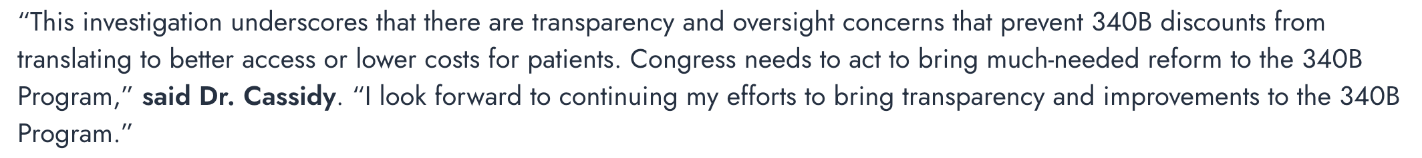
Senate HELP Committee Report on 340B
Report released on investigation based on input from hospitals, FQHCs, contract pharmacies and drug manufacturers
Report lays out specific 340B reforms needed, including:
Annual reporting on use of 340B funds
Examine financial benefit to contract pharmacies
Greater overall transparency
Defining patients and ensuring they benefit

Slide 13
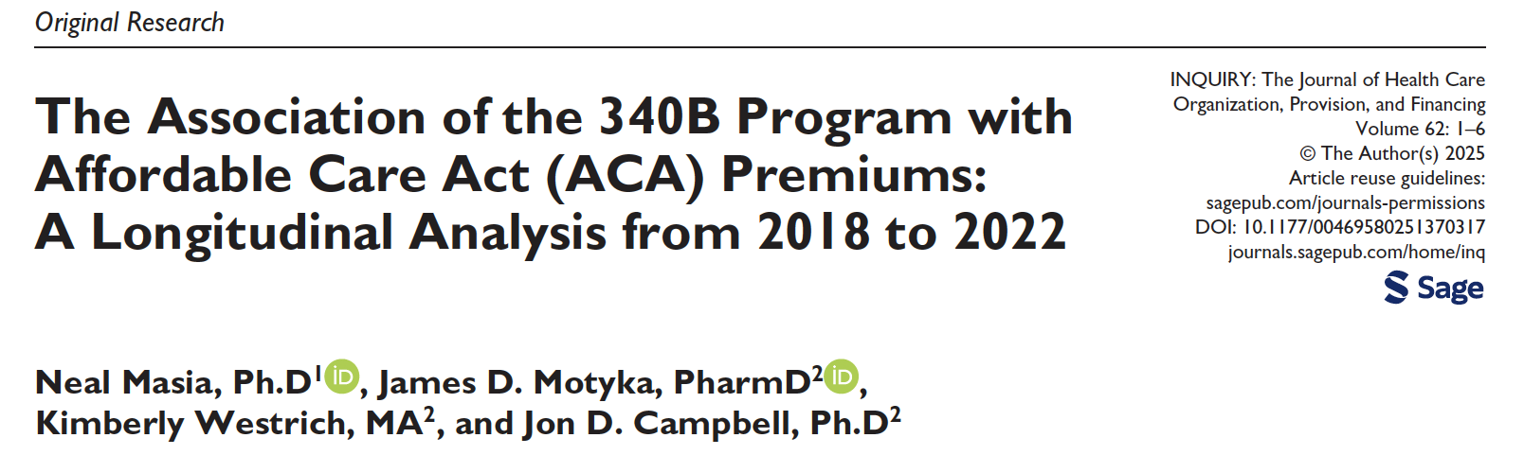
Three Landmark Reports Recently Released on 340B
CBO report on 340B hospitals
“In CBO’s assessment, the 340B program encourages behaviors—including the prescription of more and higher-priced drugs, the expansion of services, and the integration of hospitals and off-site clinics—that tend to increase federal spending.”
Analysis of 340B on ACA premiums
“340B activity is associated with 1.8% of ACA benchmark premiums and over $2 billion per year in higher ACA subsidies per year.”

Slide 14
Three Landmark Reports Recently Released on 340B
USC Schaffer Report on 340B
“Key structural issues with the program include spread pricing, 340B discounts not going to uninsured or low-income patients, and an increasing share of 340B revenues going to for-profit pharmacy chains.”
“340B was designed to subsidize safety-net hospitals “at no cost to taxpayers” but ultimately taxpayers are impacted through higher costs to Medicare, Medicaid and commercial insurance.”

Slide 15
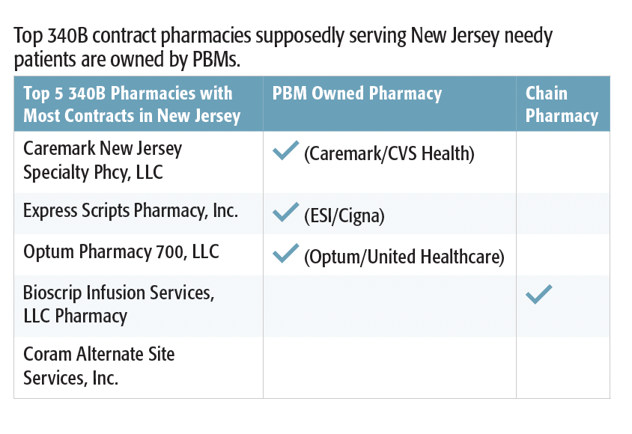
340B Contract Pharmacies

Slide 16
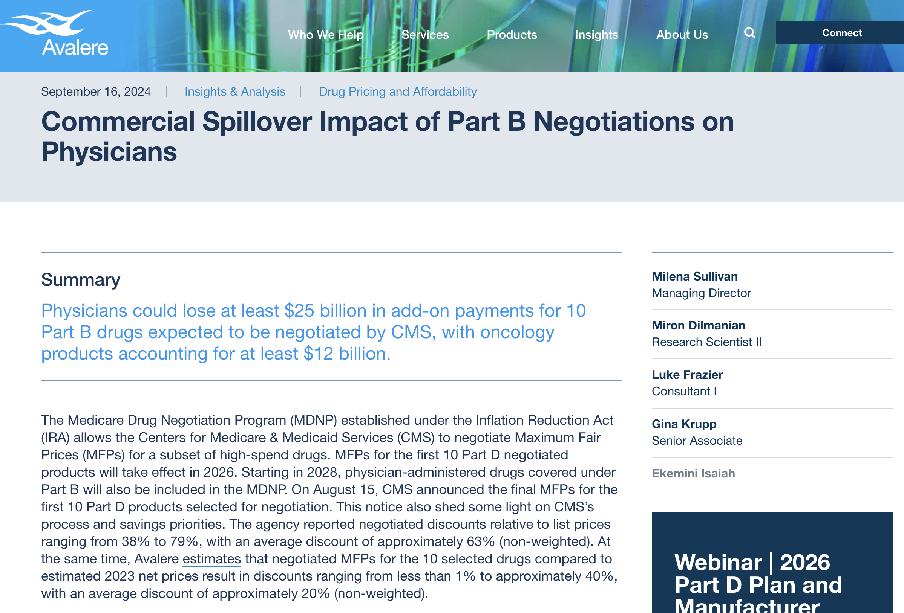
Problems with IRA Drug Price “Negotiations”
Unclear how Part D IRA “negotiated” prices will play out in rebates to pharmacy providers
Concerns that pharmacy providers will have to float the discounts until rebated
Pharmacy pushing back
Part B maximum fair price (MFP) will artificially lower the average sales price (ASP) and cause reimbursement headaches
Will likely curb investments in additional cancer drug indications, especially pediatric indications
Unclear if less research of small molecules

Slide 17
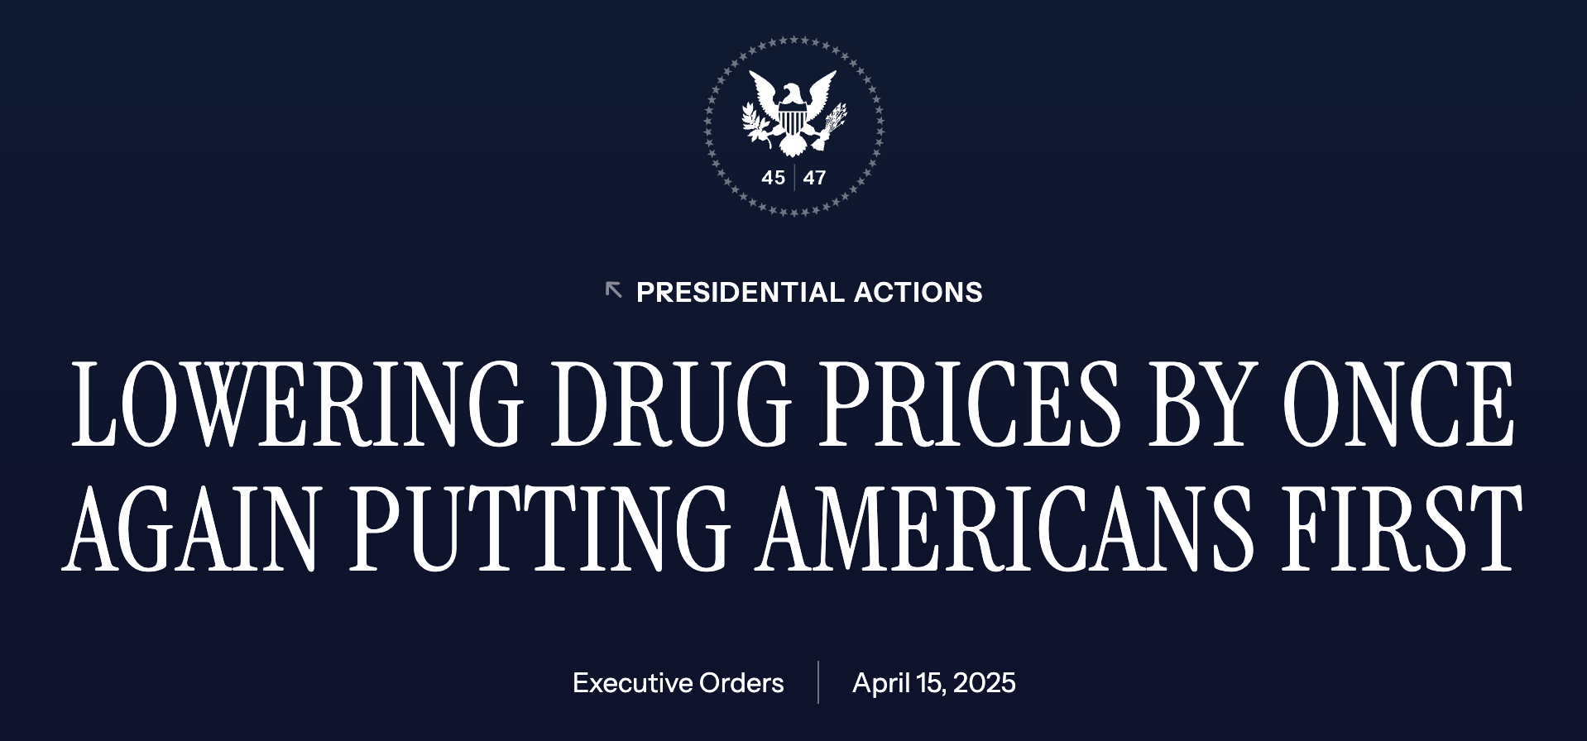
President’s EO on Lowering Drug prices
Trump’s Executive Order (EO) hits on both PBMs and hospitals, both site payment parity and 340B
Orders transparency on PBM dealings
Increases availability of generics and biosimilars
Aligns Medicare drug payment with cost (translation: drastically lower 340B reimbursement)
Specifically, insulin and epinephrine cost (at 340B discount) plus small administrative fee
Implements site payment parity for drugs (specially calls out cancer therapies)
EO eliminates the “pill penalty” in the IRA
Seeks to move “negotiation” time frame to 13 years, as with biologics
Also facilitates importation

Slide 18
COA Comment Letters on MFPS & HOPPS Rules

Slide 19
Good/Bad in Medicare Physician Fee Schedule Rule
Nice bump in payments
However, insufficient payment even in ight of the conversion factor increase
Moving to site neutrality
Introduction of the efficiency adjustment in calculating PE-RVU
Inclusion of MFP discounts in ASP calculations
CMS’ plan to no longer report ASP after MFP effective
Changes to autologous cell-based immunotherapy and gene therapy payment
MIPS TPCC measure and app attribution
MIPS Value Pathways and complexity of an ailing MIPS program

Slide 20
Good in Outpatient Hospital Fee Schedule Rule
Site Neutrality
CMS conducting a survey of 340B Hospitals’ Drug Acquisition Costs
Clear CMS moving towards reducing 340B hospital reimbursement
Hospital Price Transparency Reporting Changes

Slide 21
Pharmaceutical Tariffs & GLOBE Model
Trump tariffs being held for now
Pfizer and other companies coming to the deal table
Unclear what happens with GLOBE Model
Most Favored Nation 2.0

Slide 22
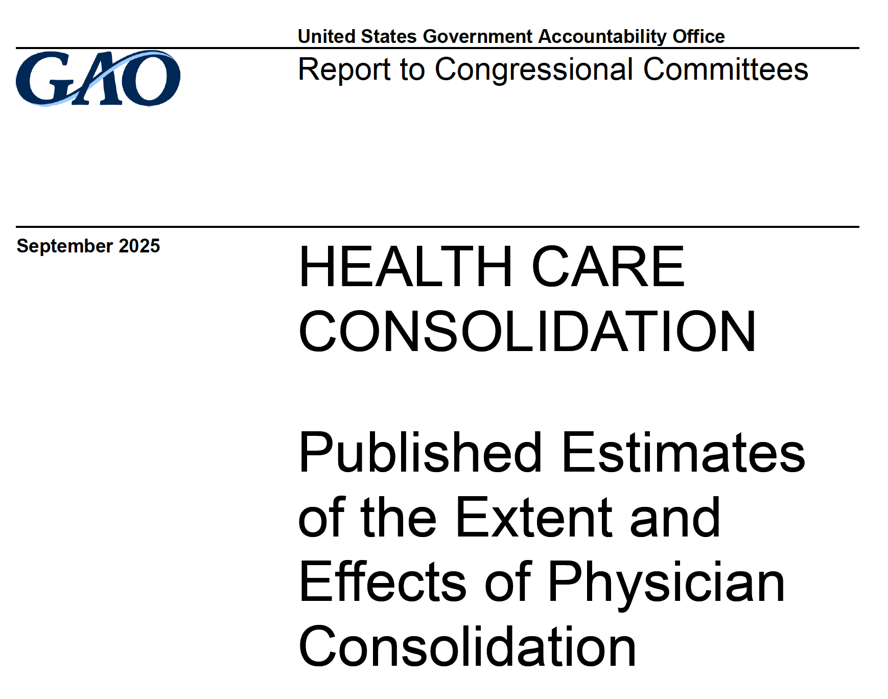
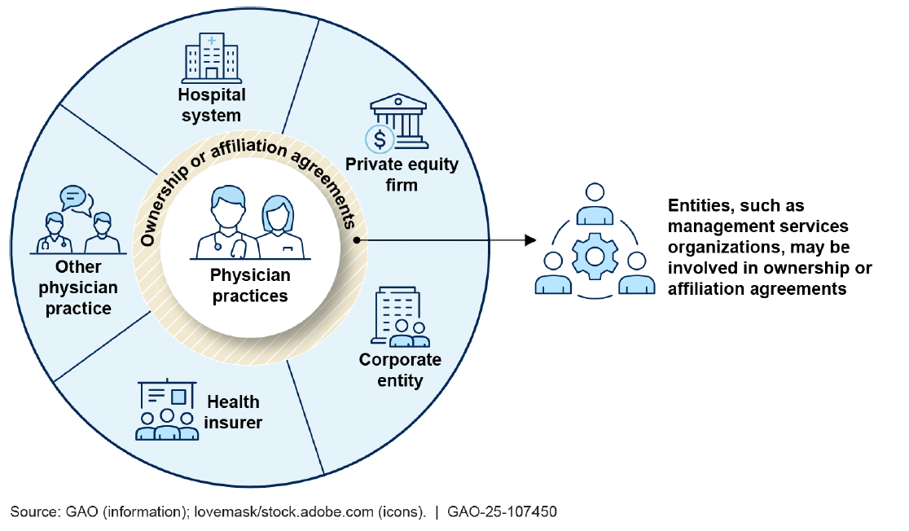
GAO Report on Practice Consolidation

Slide 23
Some Key Takeaways
Title, Text Layout
Congress and the federal government pretty much dysfunctional
Behaving like children rather that grown adults charged with representing us
Yet, serious movement on some key issues
Site neutrality
340B
Consolidation and physician pay
PBM legislation more effective at the state level
Need to keep fighting!

Slide 24
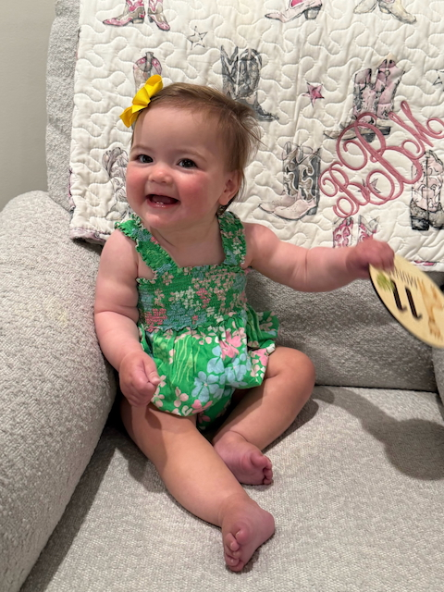
How Do I Keep My Sanity??
Ted Okon
Email: tokon@COAcancer.org
Web: www.CommunityOncology.org
Twitter: @TedOkonCOA

