Slide 1
Barrels and Benchmarks: ASCO’s 2025 Outlook on Community Oncology
NJSOM Annual Conference
October 9th, 2025

Slide 2
2026 Conversion Factor Update
A statutory 0.75% update for QPPs and a 0.25% update for non-QPPs.
A 2.5% one-year increase provided by the OBBBA.
A 0.55% positive budget neutrality adjustment (efficiency adjustment).
Year | QPs | Non-QPs | % Change QPs | % Change Non-QPs
2025 | $32.3465 | $32.3465 | -2.83 | -2.83
2026 | $33.5875 | $33.4209 | 3.84 | 3.32
Notes:
OBBA- One Big Beautiful Bill Act

Slide 3
Conversion Factor
Year | % Change QPPs | % Change Non-QPPs
2025 | -2.83% | -2.83%
2026 | 3.84% | 3.32%

Slide 4
Specialty Impact
Work, PE, MP RVU updates.
This does not include the 2.5% update from the OBBBA.
 | All Specialty Range | Hematology/ Oncology | Radiation Oncology
Total | -6% to +7% | 0% | -1%
Facility | -17% to -1% | -11% | -2%
Non-Facility | -2% to +10% | +6% | -1%

Slide 5
Work RVUs: Efficiency Adjustment
-2.5% cut applied to Work RVUs and intra-service physician time
Applies to certain non-time-based codes describing procedures, radiology services, and diagnostic tests
Includes drug administration codes*
~9,000 codes affected
Does not apply to E/M, behavioral health, care management, Medicare Telehealth services list
* Time-based drug admin codes were added to the EA list in error.

Slide 6
Work RVUs: Efficiency Adjustment
Why?
Concerns about AMA RUC survey data accuracy.
Improved provider efficiency, technology improvements, more commonly performed.
How?
Based on Medicare Economic Index (MEI) productivity adjustment.
Updated every 3 years.

Slide 7
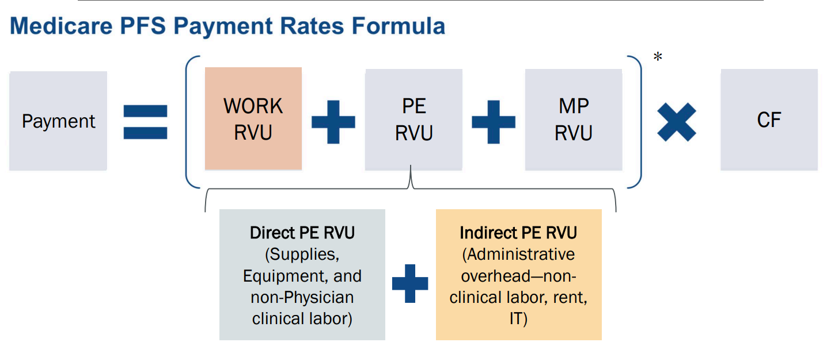
Practice Expense RVUs: Indirect PE Cost Adjustment
Indirect Practice Expense
Administrative overhead, non-clinical labor, rent, IT

Slide 8
Practice Expense RVUs: Indirect Cost Adjustment
CMS proposes to reduce the portion of facility PE RVUs allocated based on work RVUs to half the amount allocated to non-facility PE RVUs.
Non-Facility Based (+6%)
Facility Based (-11%)

Slide 9
Practice Expense RVUs: PPIS Survey Data
The Physician Practice Information (PPI) Survey was led by the American Medical Association in 2023-2024.
Primary purpose to collect representative data on practice expense and hours spent in direct patient care.
Shared with Centers for Medicare & Medicaid Services (CMS) to update the Medicare Economic Index (MEI) and the Resource Based Relative Value Scale (RBRVS).

Slide 10
Practice Expense RVUs: PPIS Survey Data
CMS proposes to maintain the current practice expense per hour (PE/HR) data and cost shares for CY 2026.
Why doesn’t CMS want to the data from the PPIS?
Low response rate
Validity, reliability, and representativeness
Impact on PFS rate setting

Slide 11
Telehealth
PHE flexibilities expired Sept. 30th.*
Provisional services → permanent
CMS does not propose to extend flexibilities related to a provider’s home address.
Direct supervision through A/V permanent for all services described as “incident-to” a physician’s professional services.
Pre-PHE policy for teaching physicians applies.

Slide 12
Principal Illness Navigation, Community Health Integration, and SDOH Risk Assessment Changes
Language revision: replacing “Social determinants of health” with “upstream driver(s)” in Navigation code descriptors.
CMS felt “upstream drivers” was more a comprehensive term, encompassing a wider range of root causes.
Deletion of G0136 “Social Determinants of Health Risk Assessment.”
Service is already included in other codes, such as E/M visits.

Slide 13
Mechanical Scalp Cooling Services
Effective January 1, 2026, in the Physician Fee Schedule and the 2026 AMA CPT Professional Edition.
Does not apply to cold capping.
CPT Code | Descriptor
97007 | Mechanical scalp cooling, including individual cap supply with head measurement, fitting and education
97008 | Mechanical scalp cooling; including hair preparation, individual cap placement, therapy initiation, and pre-cooling period
97009 | Provided after discontinuation of chemotherapy, each 30 minutes (Use in conjunction with 97008)

Slide 14
Autologous Cell-Based Immunotherapy and Gene Therapy Payment
Medicare Part B covers many cellular immunotherapies and gene therapies that are FDA-approved (ex. CAR-T).
Cells collected from patient.
Cells altered for intended therapy.
Administered to the patient.
CMS is proposing preparatory procedures for tissue procurement required for manufacturing an autologous cell-based immunotherapy or gene therapy be included in the payment of the product itself.

Slide 15
CMS Request for Information
Software as a service.
What are the direct costs associated with the use of technology vs. indirect costs?
Prevention/Management of chronic disease.
How can CMS enhance their support management for prevention and management of chronic disease?

Slide 16
CMS Request for Information
Administrative burden
‘‘Unleashing Prosperity Through Deregulation.’’
Transition to digital quality measures.
Support data standardization and alignment of requirements for the development and reporting of digital quality measures.

Slide 17
Quality Payment Program
Payment threshold → 75 points through 2028 performance year
MVPs
6 new MVPs, 21 total
Subgroup reporting
2029 full transition
QPs
75% payments or 50% patients, difficult threshold to meet
Adding NPI level in addition to entity level
attribution-eligible beneficiary to now include any covered professional service (not just E/M)

Slide 18
G2211 “Add On Complexity” Utilization
Introduced by CMS in the 2024 PFS
Resulted in a -2.2% decrease to the 2024 Conversion Factor
Based on CMS’ assumed utilization of 83.7 million reported services.
Approximate loss of $1 billion in reimbursement for all specialties.

Slide 19
Actual utilization is…..

Slide 20
26.7 million reported services

Slide 21

G2211 “Add On Complexity” Reporting
Another opportunity to maximize and build reimbursement.
One page guide to reporting on G2211 available on ASCO’s Coding and Reimbursement page.
Scan for ASCO’s Coding and Reimbursement resources.

Slide 22
Practice@asco.org

