Slide 1
Fine-Tuning the Financial Blend:
Principal Care Management and Principal Illness Navigation in Oncology Billing
Allison Hirschorn
Director of Coverage and Reimbursement
American Society of Clinical Oncology
NJSOM Fall Conference
October 9th, 2025

Slide 2
Topics
Principal Care Management
Principal Illness Navigation
Reporting and Reimbursement
Notes:
Historically, oncology practices may have performed navigational services for their patients but may not have been reimbursed for these services. This is due to multiple factors, but one is simply being unaware of how to report the services they are furnishing. Today, we’re going to discuss the two main services that encompass activities that navigators perform: care management and principal illness navigation, and how these services are reported for reimbursement.

Slide 3
Care Management

Slide 4
Goals of Care Management Services
Improve care coordination.
Reduce hospital admissions or services.
Engaging patients and caregivers.
Goals of Care Management Services

Slide 5
Care Management Services
Chronic Care Management
Two or more chronic conditions expected to last at least 12 months.
Complex Chronic Care Management
Two or more chronic conditions expected to last at least 12 months.
Moderate or high complexity medical decision making.
Principal Care Management
One high-risk, complex chronic condition expected to last at least 3 months.
Complex care to comorbidities.
Notes:
Many oncology practices have provided care coordination due to the nature of the patients that are served. Many of oncology patients have multiple chronic conditions. There are three different care management services for patients who are significant risk of death, exacerbation or decline.
Chronic care management patients have two or more chronic conditions expected to last at least 12 months.
Complex chronic care management patients also have two or more chronic conditions that are expected to last at least 12 months, but these patients also require a moderate or high level of medical decision making in their care.
Finally, principal care management patients have one high-risk complex chronic condition that is expected to last at least 3 months. Care is unusually complex due to comorbidities or requires frequent adjustments.

Slide 6
Practice Requirements
24/7 access to physicians/QHP or clinical staff
Required Actions
Obtaining patient consent
Timely access and management for follow-ups
Timely access to information through an EHR
Coordination and integration of care among all service professionals (within and outside the practice)
A physician or QHP who oversees the activities of the care team.
A designated member of the care team to provide continuous care
Assigning a designated care team lead
Establishing, implementing, revising, and monitoring the care plan
Recording data in the electronic health record
Practice Administration and Workflow
Notes:
There are activities and requirements from the practice and clinical team to provide any care management services.

Slide 7
Physician/QHP
Develop a comprehensive care plan and assessment.​
Clinical Staff
Educate patient and/or caregiver.
Address all health issues (medical and psychosocial).​
Focus on patient’s chronic condition(s).
Provide guidance and direction to clinical staff.
Respond to patient inquiries.
Reconcile medications list (including those prescribed by other providers).
Manage care transitions.
Share information with other health care providers.
Physician and Clinical Staff Activities
Notes:
In addition to practice requirements, the physician/QHP is to…
Staff may…

Slide 8
Care Plan
Problem list
Expected outcomes and prognosis
Measurable treatment goals
Symptom management
Planned interventions
Medication management
Community/social services ordered
Schedule for review and revisions

Slide 9
Time Requirements for Care Management Services
Report based on total time per calendar month.
Time requirements must be met or exceeded.
Date of service is the date the time requirement was reached.
Notes:
These are time based codes. The time for a specific service is the total time for the calendar month, not for a specific date when services were rendered. Time must meet or exceed that in the code description. Because there are specific time instructions, the mid point rule does not apply for these codes. The date of service for the billed charges would be the date in which the time requirement is reached. The time required is in the code descriptors, which we will cover a little later in our reporting requirements.

Slide 10



Care Management Challenges
Chronic and Complex Care Management Services
Principal Care Management Services
Only one clinician per beneficiary per calendar month.
More than one clinician per beneficiary if the patient experiences an exacerbation of more than one complex chronic condition simultaneously.
Notes:
One misconception about these codes is that they’re for primary care only. While not true, certain care management codes have limitations on who can report these services. Chronic and Complex Care management services can only be reported by one clinician per beneficiary per calendar month. Principal care management codes on the other can be billed by more than one clinician if the patient experiences an exacerbation of more than one complex chronic condition simultaneously. For example, if the primary care physician is managing the patient’s diabetes and the oncologist is addressing an exacerbation with the patient’s cancer.

Slide 11
Documentation
Initiating visit performed.
Narrative detailing need for care management services.
Comprehensive care plan (with measurable goals) established, implemented, revised or significantly monitored.
Patient or caregiver must be given a copy of the care plan.
Advanced informed consent (verbally for patients who have been seen in the practice within past 12 months or written for those who have not).
Support services rendered.
Time spent on services.
Notes:
Initiating visit, either an AWV, E/M visit.

Slide 12
Principal Illness Navigation

Slide 13
Goal of Principal Illness Navigation
Address patient barriers
Improve access to timely care
Support patient self-advocacy

Slide 14
Principal Illness Navigation (PIN)
Services focused on a serious, high-risk condition.
Performed by auxiliary personnel.
Condition expected to last at least 3 months.
Significant risk of death, exacerbation, decline.
Requires disease specific care plan.
Notes:
Principal Illness Navigation is similar to Principal Care Management, but with a different intent and focus. Whereas principal care management is more clinical in nature, principal illness is more personalized to the individual patient to guide the patient through their care, which we will see in some of the aspects of the activities involved. Principal Illness Navigation is performed by certified or trained auxiliary personnel in specific. Auxiliary personnel are individuals who perform services under the supervision of the physician or qualified health provider. These personnel may include clinical navigators, financial or lay navigators, mental health navigators, and other individuals who provide these services.

Slide 15
Performing Provider vs Billing Provider
Auxiliary personnel typically provide navigation services.
Billing provider must remain involved in care.
Notes:
These services are usually performed by auxiliary personnel under general supervision of the provider. The auxiliary personnel must represent a financial expense to the practice, by either direct employment or contractual or leased agreement. All services must be reported by the billing provider who performed the initiating visit. The billing provider must be able to report services independently.
During the period, it is expected that the provider remain actively involved in the care of the patient.

Slide 16

Reporting Restrictions
Principal Illness Navigation
More than one clinician per beneficiary if different conditions.

Slide 17
Examples of Required Certification or Training
Patient and family communication
Interpersonal and relationship-building
Patient and family capacity-building
Service coordination and system navigation
Patient advocacy, facilitation
Individual and community assessment
Professionalism and ethical conduct
Development of an appropriate knowledge base.
Certified/trained on serious, high-risk condition
Notes:
CMS defers to state law regarding necessary certification, licensure, and scope of practice for auxiliary personnel. In lieu of applicable state requirements, CMS does state that they expect training or a certification program for the auxiliary personnel performing these services to cover the following areas.

Slide 18
Principal Illness Navigation Activities
Communicate
Educate
Coordinate
Facilitate
Navigate
Care Planning
Notes:
Auxiliary personnel activities include
communicating with all service providers regarding the patient’s psychosocial requirements, preferences and desired outcomes.
Building self-advocacy skills and educating the patient on how to best participate in medical decision-making. This may include providing the patient with information on participation in clinical trials for principal illness navigation.
Coordinating services and care transitions between all community and healthcare-based providers and practitioners.
Facilitating access to community based social services, healthcare access.
Providing social and emotional support to cope with the problem addressed, SDOH needs, daily routines in order to meet treatment goals. In addition to social emotional support, staff may also provide mentorship and inspiration.
Establishing an action plan through a person-centered assessment.

Slide 19
Principal Illness Navigation: Documentation Requirements
Initiating visit identifying medical necessity for navigation services and establishes a treatment plan for problem.
Time spent in relationship to the serious, high-risk illness.
Description of activities performed in relation to the treatment plan.
Consent obtained.
Notes:
Principal Illness Navigation is similar to that of Principal Care Management but with a different focus. Principal Illness Navigation also requires an applicable initiating visit that identifies the medical necessity for navigational service needs being identified at the initiating visit. What about this patient’s condition requires navigational services? Time spent furnishing navigational services must be documented in the medical record, however with PIN the time is that which was spent in relation to the serious, high-risk condition and accompanies a description of the actual activities performed. Consent must be obtained to perform these services.

Slide 20
Principal Illness Navigation: Consent Requirements
Advanced informed consent, either written or verbal, is required to be documented in the patient’s medical record before providing services.
Cost-sharing.
Patient’s rights to stop services.
Must be done annually.
Notes:
More about that consent… The patient should be aware of applicable cost-sharing and the ability to discontinue the services at any time.

Slide 21
PCM and PIN Similarities
Care Coordination
Access Facilitation
Communication

Slide 22
Principal Illness Navigation | Principal Care Management
Certified/Trained Staff | Physician/QHP/Clinical Staff
Identifying and/or referring for services | Ongoing review of patient status
Action plan | Care plan
Patient-centered assessment | Assess adherence to treatment regimen and medication management; collection of health outcomes data and registry documentation
Patient education focused on contextualizing info from the treatment team, build patient self-advocacy skills, provide info and resources to patient to consider for participation in clinical trials/research. | Education to support self-management and daily living.
Providing social and emotional support to help patient cope with addressed problem(s), SDOH needs, and daily routines to meet diagnosis and treatment goals; provide support, mentorship, or inspiration to meet treatment Goals. | While supporting adherence of the treatment regimen and medication management is mentioned, how that support is given is not specified.
PCM and PIN Differences

Slide 23
Reporting and Reimbursement

Slide 24
Principal Care Management Reimbursement
 | Principal Care Management
 | Services | Reimbursement
Clinical staff | 1st 30 minutes of time directed by a physician/QHP Each additional 30 minutes (limit 2) | 99426: $50.46 99427: $46.17
Physician/ QHP | 1st 30 minutes Each additional 30 minutes (limit 2) | 99424: $80.87 99425: $58.87
Reimbursement reflects national amounts for the non-facility setting. Actual amounts will vary by location. Cost-sharing applies. Date of service reporting: Reported per calendar month.
CPT Copyright 2024 American Medical Association. All rights reserved.​
CPT® is a registered trademark of the American Medical Association​
Notes:
Principal care management may also be provided by the staff OR physician/QHP.

Slide 25
Common Reasons for Claim Denials
Multiple claims for the same beneficiary:
  Two or more providers submitting claims for either a complex or non-complex CCM service.
  One provider submitting multiple initial care management services for the same patient.
  Service reported by both clinical staff and the physician/QHP.
Not meeting the service’s time requirements.
Reporting complex chronic care services, chronic care services or principal care management services during the same time period (calendar month).
Reporting care management services with other overlapping services.

Slide 26
Principal Illness Navigation: Reimbursement
Service | Reimbursement
Principal Illness Navigation 60 minutes per calendar month Each additional 30 minutes per calendar month | G0023: $77.96 G0024: $48.52
Reimbursement reflects national amounts for the non-facility setting. Actual amounts will vary by location. Cost-sharing applies. Date of service reporting: Reported per calendar month. No frequency limits.
Notes:
Principal Illness Navigation reimbursement was based the values of the care management services. G0023 is for 60 minutes per calendar month of services performed, and G0024 for each additional 30 minutes. While we indicated the reimbursement for the non-facility setting, CMS does reimburse for the services in both the facility and non-facility setting.
To be noted, the add-on codes currently have no frequency limits imposed.

Slide 27
Resources

Slide 28
ASCO Resources
Care Management Services
Care Management and Patient Navigation Services Comparison
CMS Resources
Care Management Services
CMS Health-Related Social Needs FAQ
Chronic Care Management FAQ

Slide 29
Evidence Based Tools
NCCN Distress Thermometer
The AHC Health-Related Social Needs Screening Tool
Protocol for Responding to and Assessing Patients' Assets, Risks, and Experiences (PRAPARE) tool
The Health Leads Screening Toolkit
WellRx Questionnaire

Slide 30
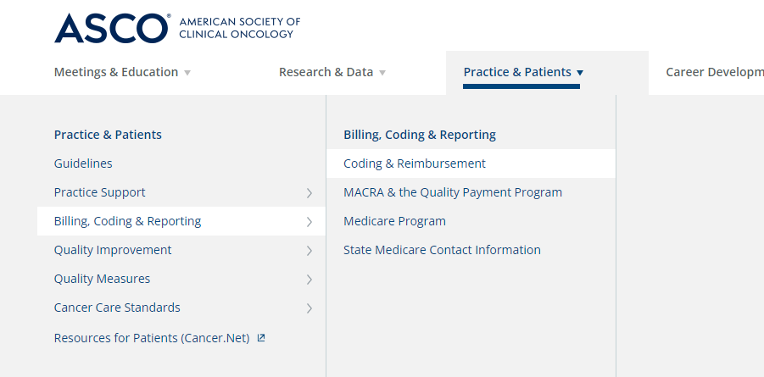

Go to www.asco.org
Select “Coding & Reimbursement” under the “Billing, Coding, and Reporting” tab.

Slide 31
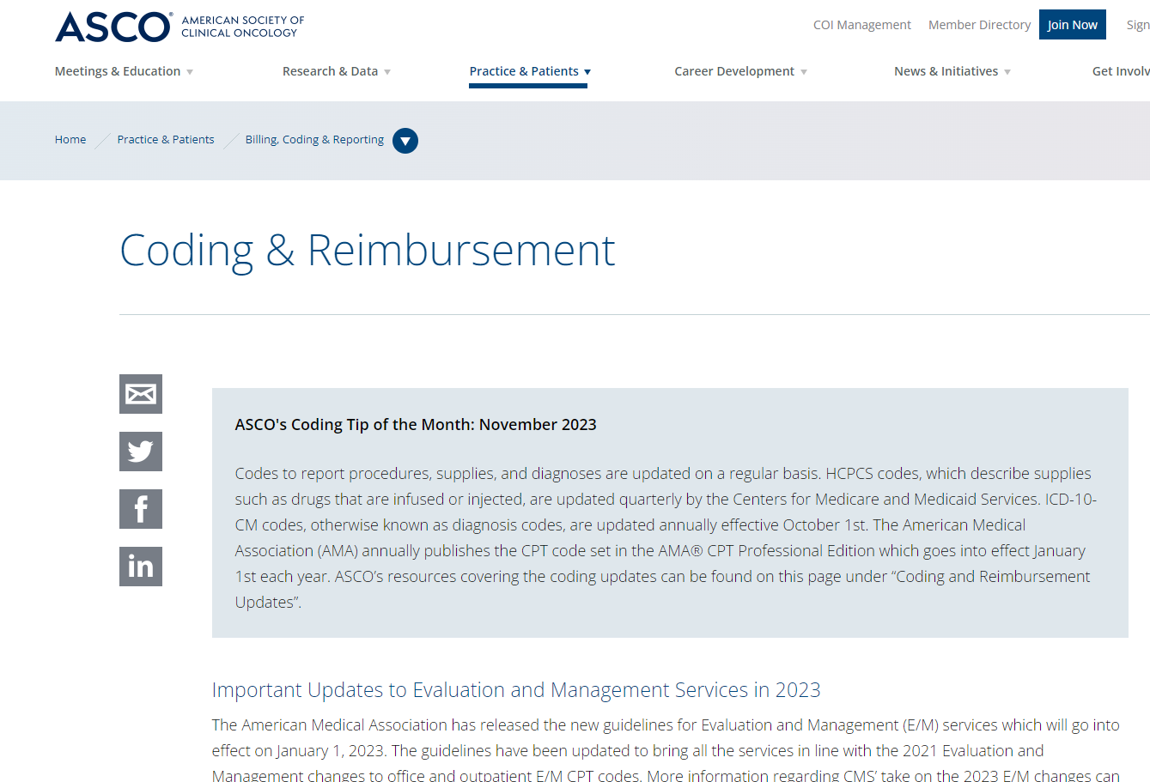
Coding and Reimbursement Resources
Available Resources
Tip of the Month
HCPCS and ICD-10 Updates
Updates to E/M Services in 2021 and 2023
Practice Administration Guides

Slide 32

Maximize reimbursement by adding to the foundation of services currently being billed.
Patient Navigation
Add On Complexity
Care Mgmt.
Drug Admin
E/M

Slide 33
Practice@asco.org

